Slide 1
Wired Xbox 360 Controller / MATLAB Interface
By: Jonathan Hoy

Slide 2
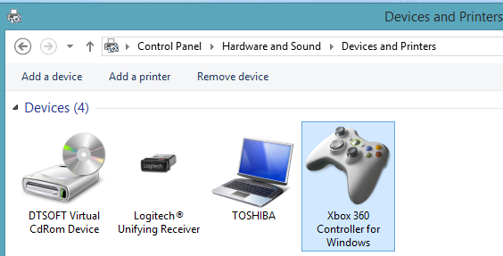
Initial Setup
Plug in the Controller
Make sure the USB Driver for your controller is properly installed:
To verify go to Control Panel -> Hardware and Sound -> Devices and Printers
Controller Should Show up

Slide 3
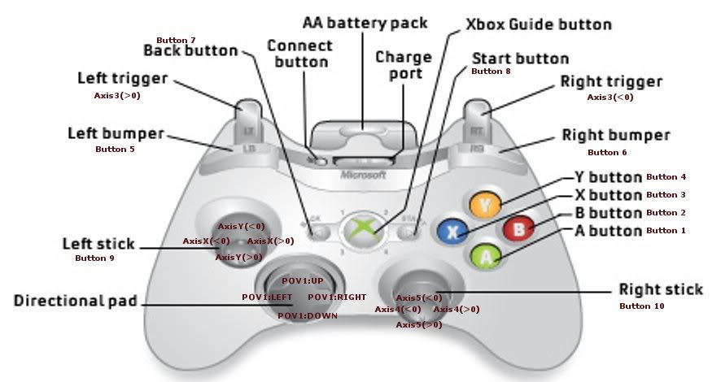
Button Reference

Slide 4
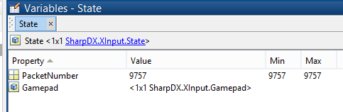
SharpDX.Xinput.State
Packet Number:
If this number changes between polling, a button or trigger is being pressed
Gamepad: This is the structure which contains the measured values on the controller.

Slide 5
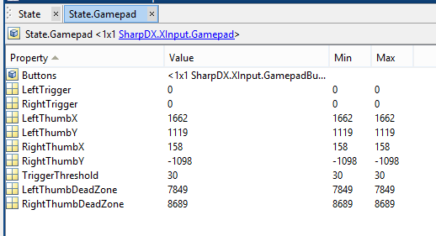
Gamepad Structure
16 Bit integer containing states of 13 buttons (3 reserved bits)

Slide 6
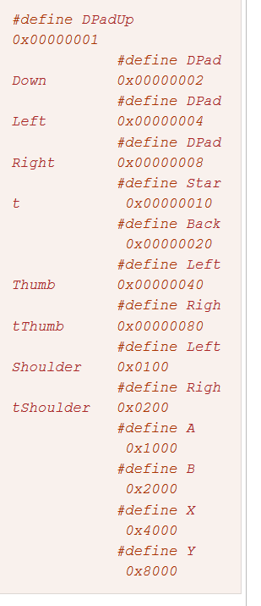
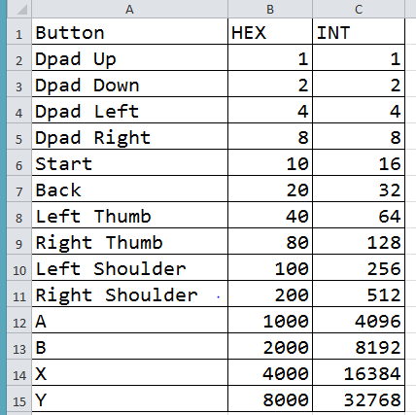
Button Parsing
Performing the Bitmask Conversions in Excel, and then stick in MATLAB sub-function for parsing

Slide 7
ButtonParser.m file
Takes care of the parsing for you and puts it into a nice structure for you

Slide 8
Sample Code Location
https://github.com/JonHoy/MATLAB_Joystick_Control

